Slide 1
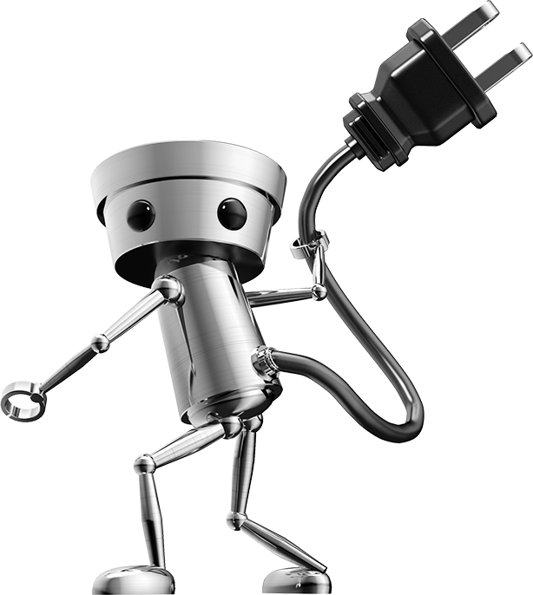
Smart Robotic Arm
Presented by:
Sudarsun S
Logesh M
Kishodharani S
From:
Karpagam College of Engineering
This Photo by Unknown Author is licensed under CC BY-SA

Slide 2
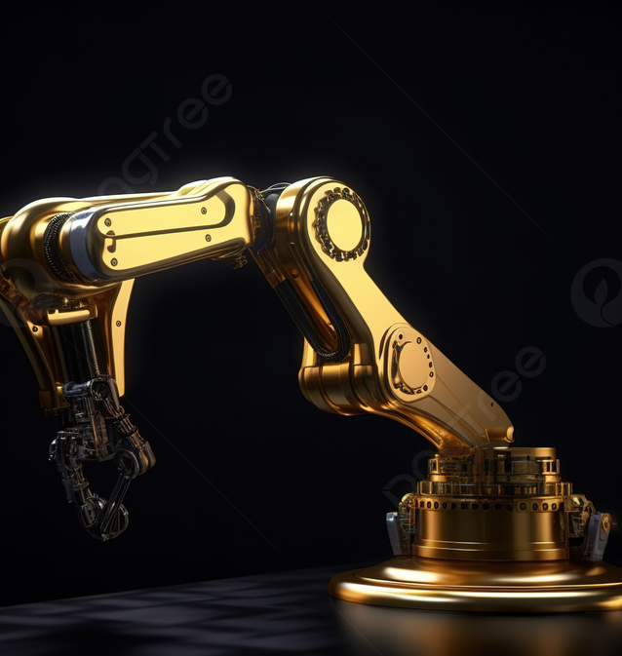
Problem Description
Robot manipulator and a mechanical arm, usually programmable, with similar functions to a human arm.
This system reduces the workplace injuries of manual labors and also robot being designed to ease the sorting process of heavy materials.
By integrating this setup, enhanced precision and quality of the manufracturing product can be provided.

Slide 3
Functionality
Robotic arms find numerous other applications in Industries. Their versatility, precision, and ability to work in hazardous or hard-to-reach environments make them valuable tools in a wide range of industries.
They are widely used in manufacturing for tasks such as picking, placing, and assembling components.
In this project the robotic arm functions similar to a arm which can grab an object. This arm can be used to pick and drop an object. This arm can be controlled by hand tilting and gestures of the user's hand. It uses mpu 6050 sensor to sense the tilting of an object and moves accordingly.

Slide 4
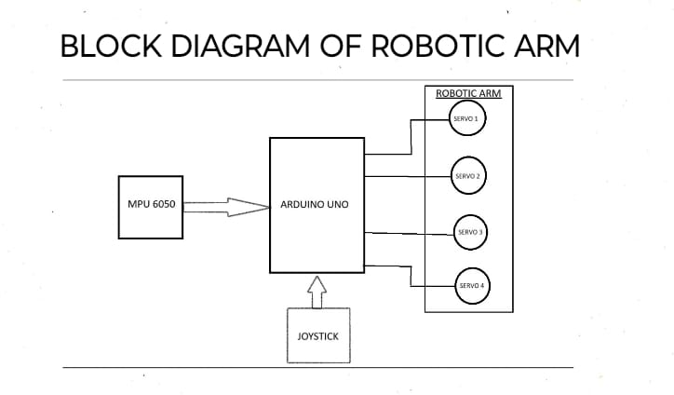
Block Diagram

Slide 5
Future Scope
Advanced Automation and Industry : Robotic arms will be at the forefront of the ongoing industrial revolution, becoming an integral part of smart factories and Industry 4.0. They will work in tandem with IoT devices and AI systems to optimize manufacturing processes and respond dynamically to changing production demands.
Medical Robotics: Robotic arms will see increasing use in the medical field for surgeries, diagnostics, and rehabilitation. They will become more precise and minimally invasive, enabling surgeons to perform complex procedures with higher levels of accuracy.

Slide 6


